Slide 1
CENG401 MACHINE LEARNING AND ARTIFICIAL INTELLIGENCE
WEEK-7
MDP-II
Asst.Prof.Dr. Murat ŞİMŞEK

Slide 2
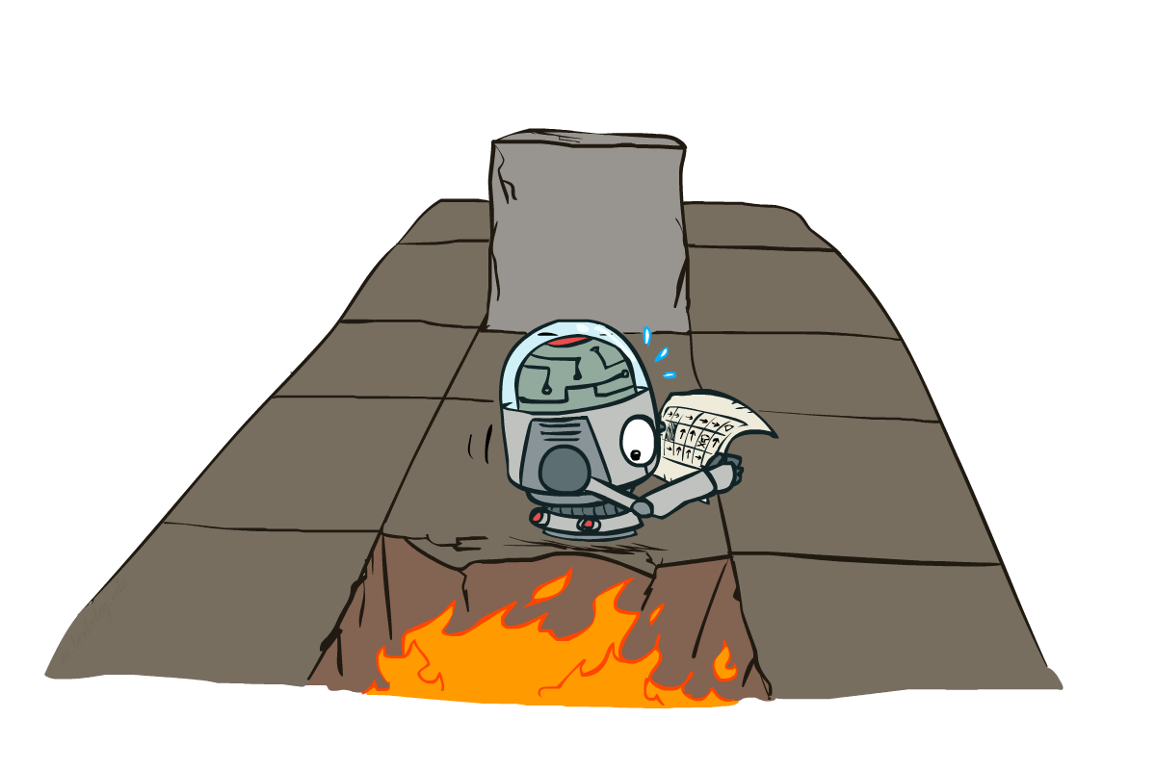
Markov Decision Processes II
Notes:
Intelligent agents are supposed to maximize their performance measure.

Slide 3
MDP Basics and Terminology
An agent must make a decision or control a probabilistic system
Goal is to choose a sequence of actions for optimality
Defined as <S, A, P, R>
MDP models:
Finite horizon: Maximize the expected reward for the next n steps
Infinite horizon: Maximize the expected discounted reward.
Transition model: Maximize average expected reward per transition.
Goal state: maximize expected reward (minimize expected cost) to some target state G.
Notes:
Intelligent agents are supposed to maximize their performance measure.

Slide 4
Markov Decision Processes II
Markov decision processes formally describe an environment for reinforcement learning
Where the environment is fully observable
i.e. The current state completely characterizes the process
Almost all RL problems can be formalized as MDPs, e.g.
Optimal control primarily deals with continuous MDPs
Partially observable problems can be converted into MDPs
Bandits are MDPs with one state
Notes:
Intelligent agents are supposed to maximize their performance measure.

Slide 5
Recap: Defining MDPs
Markov decision processes:
Set of states S
Start state s₀
Set of actions A
Transitions P(s’|s,a) (or T(s,a,s’))
Rewards R(s,a,s’) (and discount γ)
MDP quantities so far:
Policy = Choice of action for each state
Utility = sum of (discounted) rewards
s
a
s, a
s,a,s’
s’

Slide 6
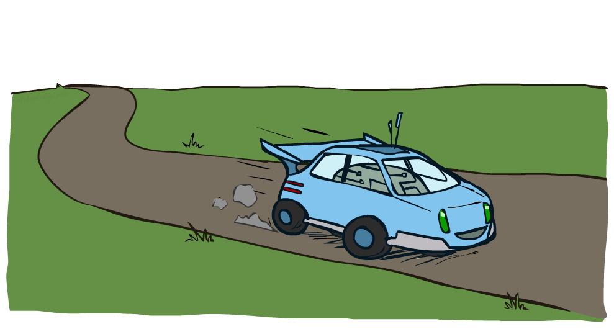
Example: Racing

Slide 7
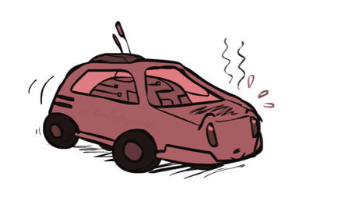
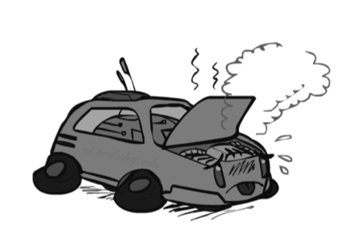

Example: Racing
A robot car wants to travel far, quickly
Three states: Cool, Warm, Overheated
Two actions: Slow, Fast
Going faster gets double reward
0.5
+1
1.0
Fast
Slow
-10
+1
0.5
Warm
Slow
Fast
0.5
+2
Cool
0.5
Overheated
+1
1.0
+2

Slide 8



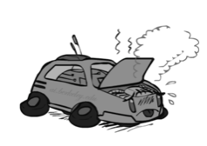
Racing Search Tree

Slide 9



MDP Search Trees
Each MDP state projects an expectimax-like search tree
s
s is a state
a
(s, a) is a q-state
s, a
(s,a,s’) called a transition
T(s,a,s’) = P(s’|s,a)
R(s,a,s’)
s,a,s’
s’
Notes:
In MDP chance node represents uncertainty about what might happen based on (s,a) [as opposed to being a random adversary]
Q-state (s,a) is when you were in a state and took an action

Slide 10
Reward Function
Directly associated with state
Denoted R(I)
Simplifies computations seen later in algorithms presented
Sometimes, reward is assumed associated with state,action
R(S, A)
We could also assume a mix of R(S,A) and R(S)
Sometimes, reward associated with state, action, destination-state
R(S,A,J)
R(S,A) = Σ R(S,A,J) * P( J | S, A)
Notes:
Intelligent agents are supposed to maximize their performance measure.

Slide 11
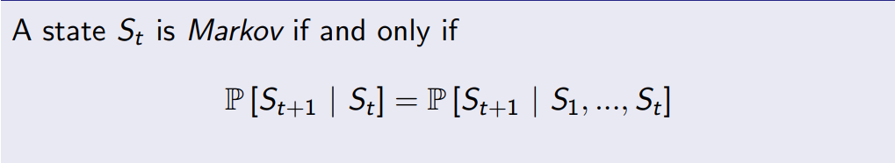
Markov Property
The state captures all relevant information from the history
Once the state is known, the history may be thrown away
i.e. The state is a sufficient statistic of the future
Notes:
Intelligent agents are supposed to maximize their performance measure.

Slide 12
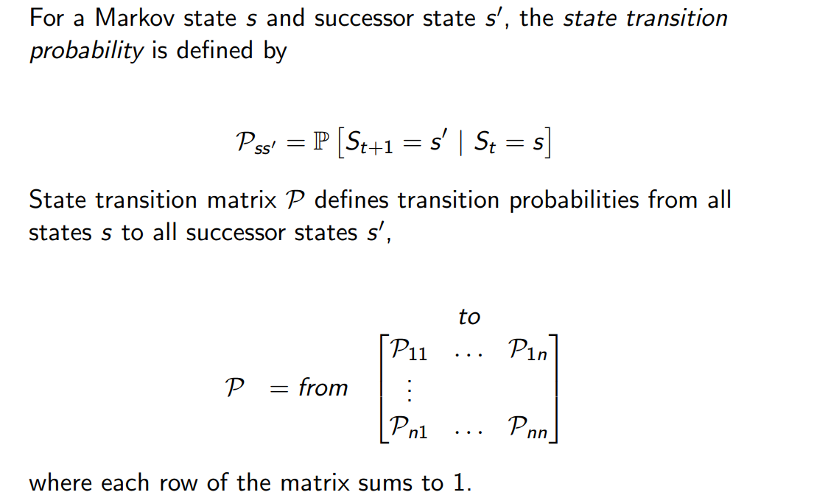
Markov Property
Notes:
Intelligent agents are supposed to maximize their performance measure.

Slide 13
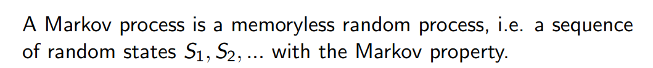
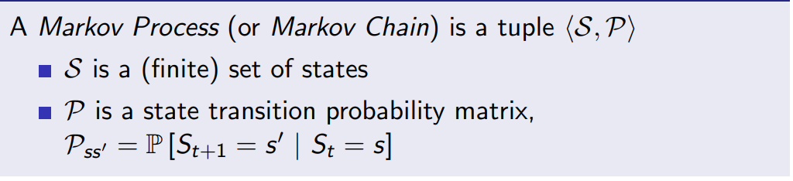
Markov Process
Notes:
Intelligent agents are supposed to maximize their performance measure.

Slide 14

Solving MDPs

Slide 15
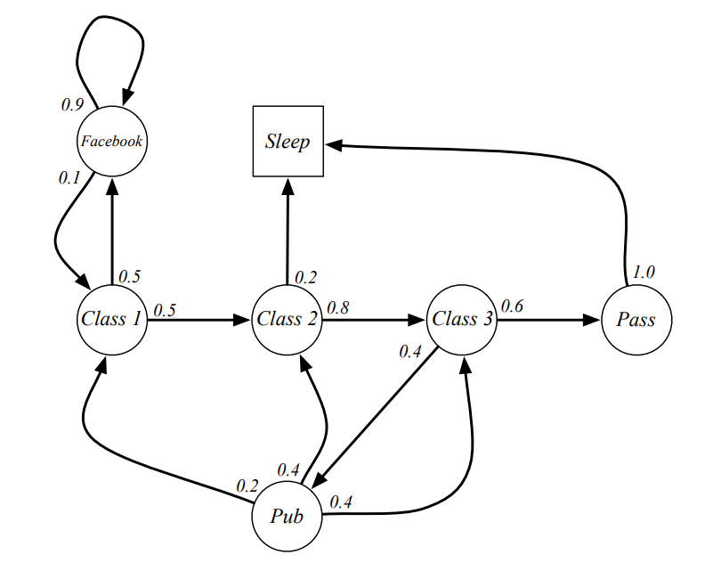
Example of Markov Chain
Find transition probability matrix.

Slide 16
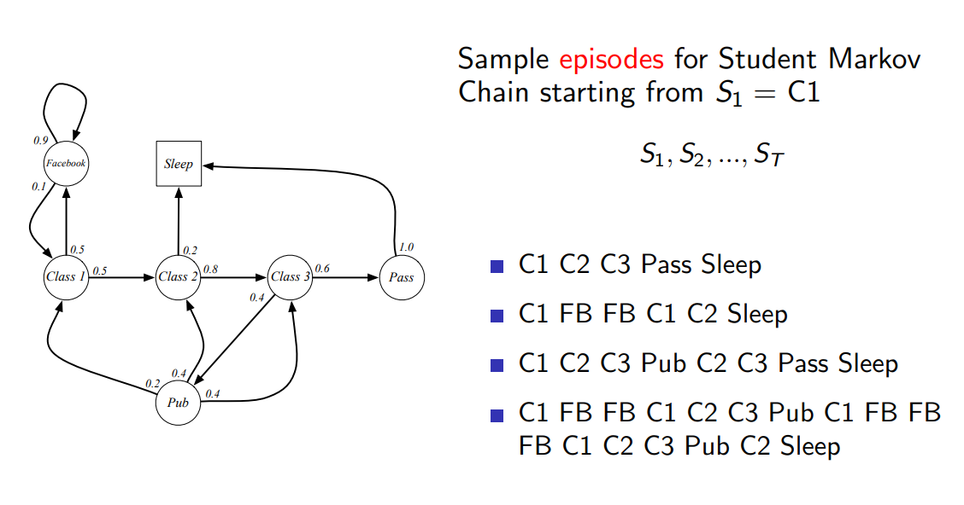
Example of Markov Chain

Slide 17
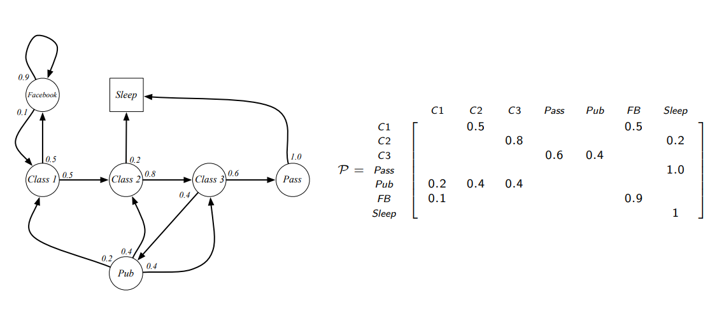
Example of Markov Chain

Slide 18
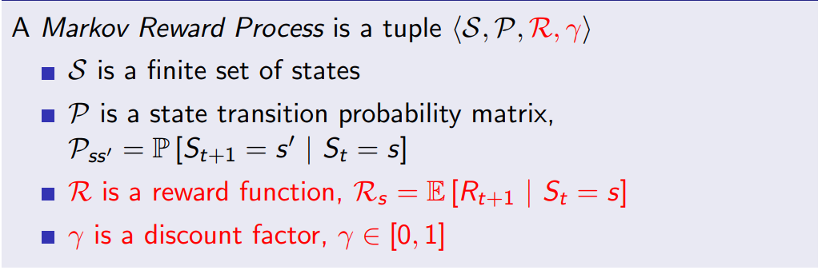
Markov Reward Process

Slide 19
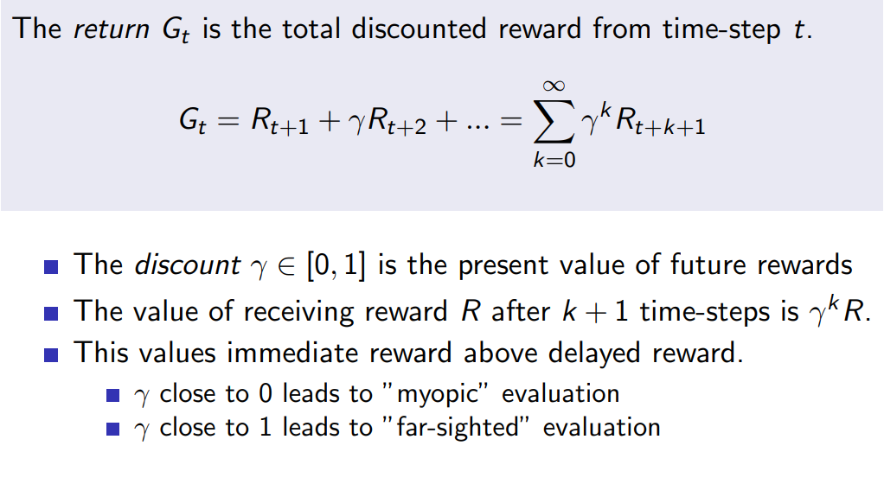
Return

Slide 20




Discounting
It’s reasonable to maximize the sum of rewards
It’s also reasonable to prefer rewards now to rewards later
One solution: values of rewards decay exponentially
Worth Now
Worth Next Step
Worth In Two Steps

Slide 21
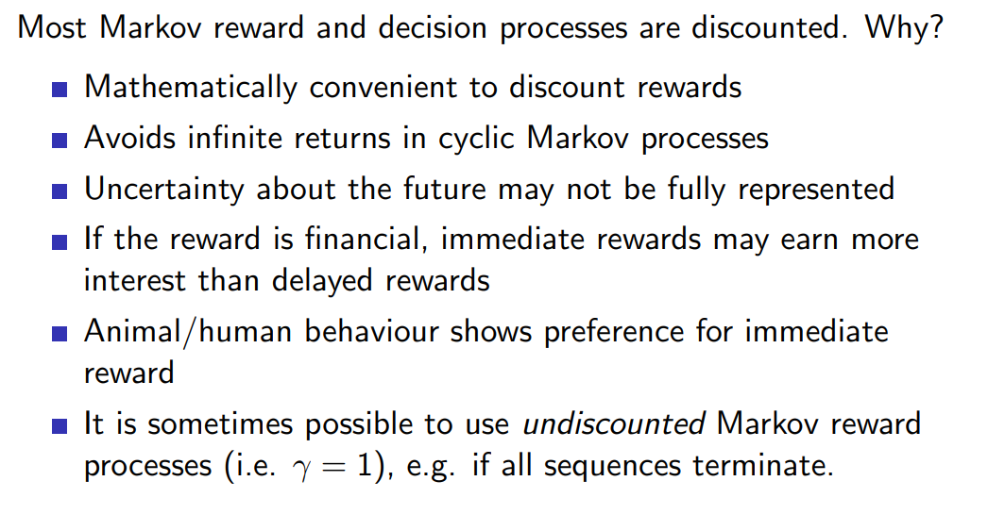
Why discount?

Slide 22

Discounting
How to discount?
Each time we descend a level, we multiply in the discount once
Why discount?
Sooner rewards probably do have higher utility than later rewards
Also helps our algorithms converge
Example: discount of 0.5
U([1,2,3]) = 1*1 + 0.5*2 + 0.25*3
U([1,2,3]) < U([3,2,1])
Notes:
Rewards in the future (deeper in the tree) matter less
Interesting: running expectimax, if having to truncate the search, then not losing much; e.g., less then \gamma^d / (1-\gamma)

Slide 23
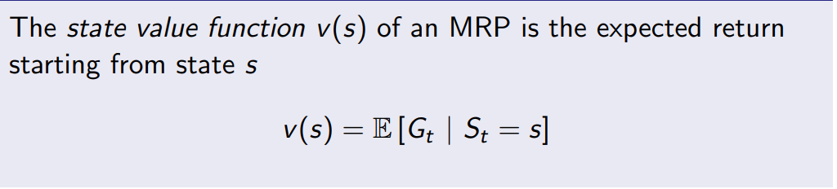
Value Function

Slide 24
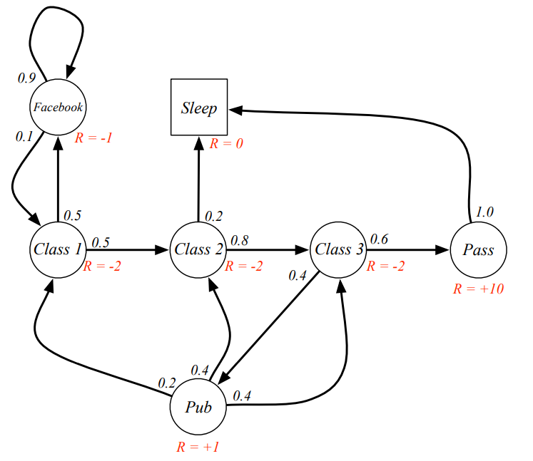
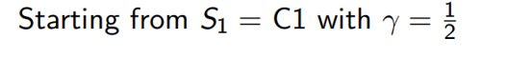
Student MRP
Calculate all value functions.

Slide 25
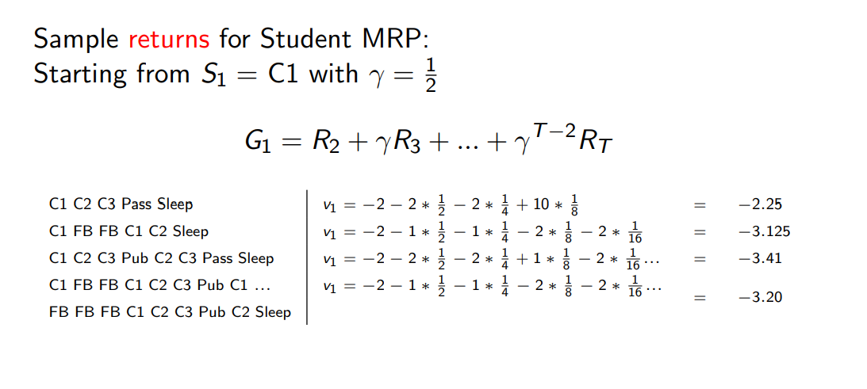
Student MRP Returns

Slide 26
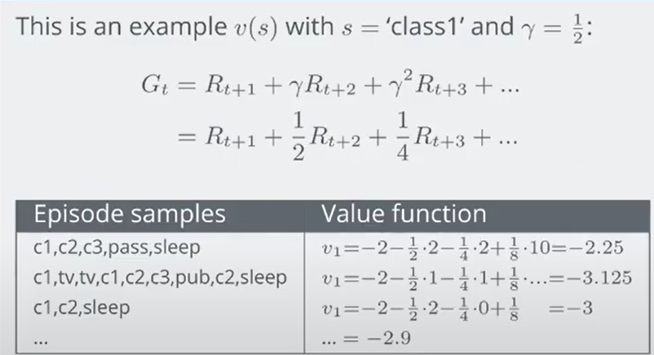
Student MRP Returns

Slide 27

Policy Methods

Slide 28
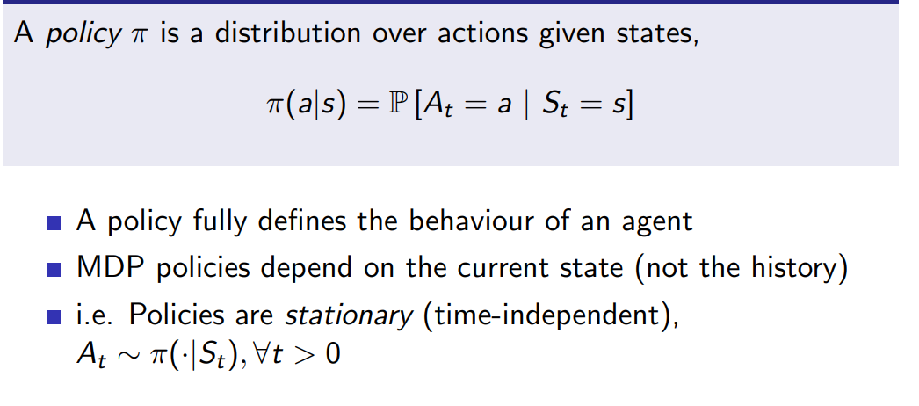
POLICIES

Slide 29

The Bellman Equations
How to be optimal:
Step 1: Take correct first action
Step 2: Keep being optimal

Slide 30
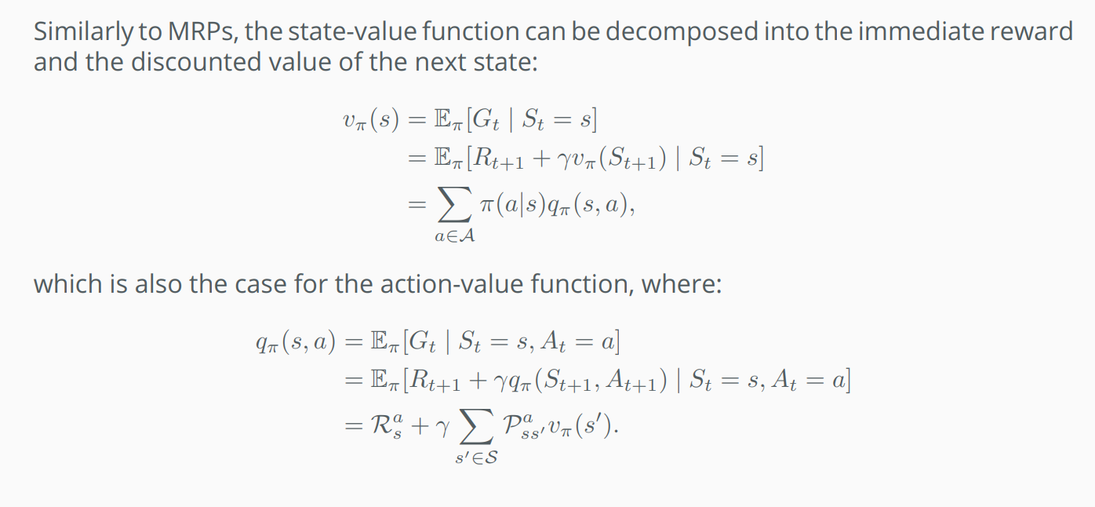
BELLMAN EQUATION

Slide 31
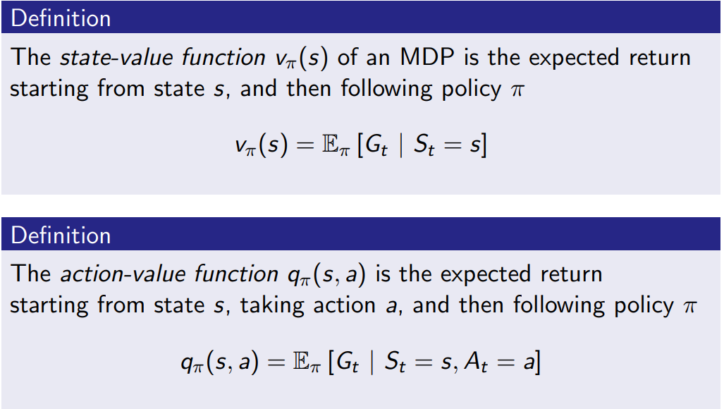
STATE AND ACTION VALUE FUNCTIONS

Slide 32
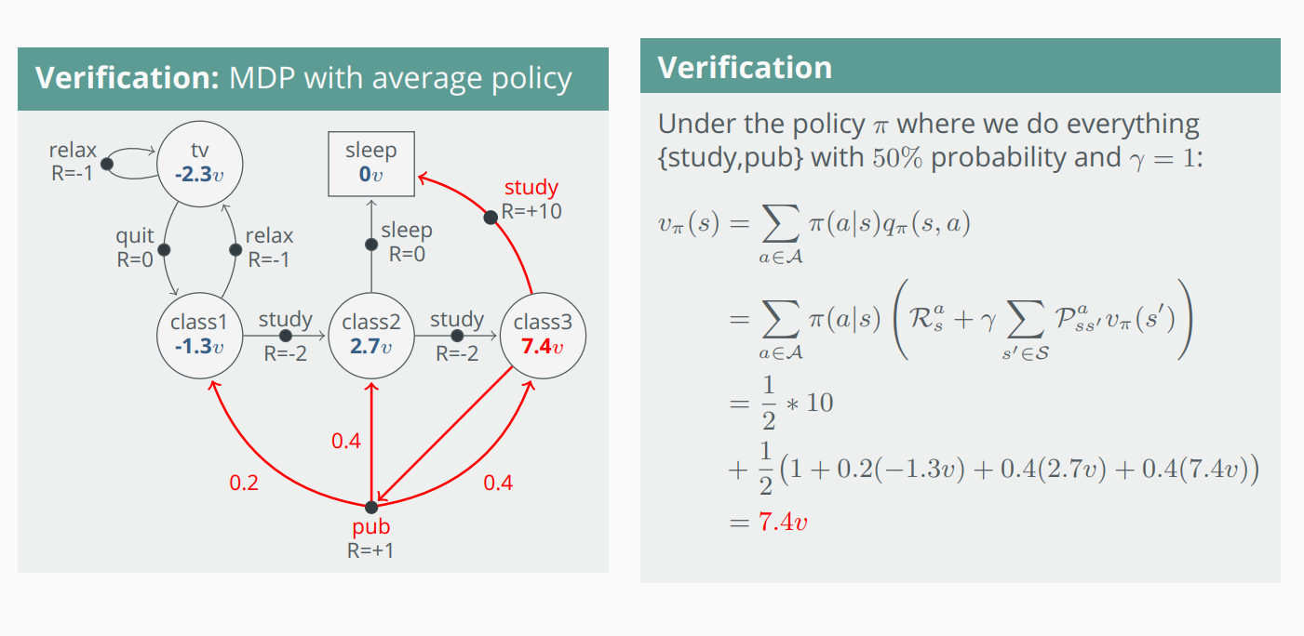
EXAMPLE VERIFYING THE BELLMAN EQUATION

Slide 33
Optimal Quantities
The value (utility) of a state s:
V*(s) = expected utility starting in s and acting optimally
The value (utility) of a q-state (s,a):
Q*(s,a) = expected utility starting out having taken action a from state s and (thereafter) acting optimally
The optimal policy:
π*(s) = optimal action from state s
s
s is a state
a
(s, a) is a q-state
s, a
s,a,s’
(s,a,s’) is a transition
s’
Notes:
Demo just shows V and Q values, snapshots on next slides.

Slide 34
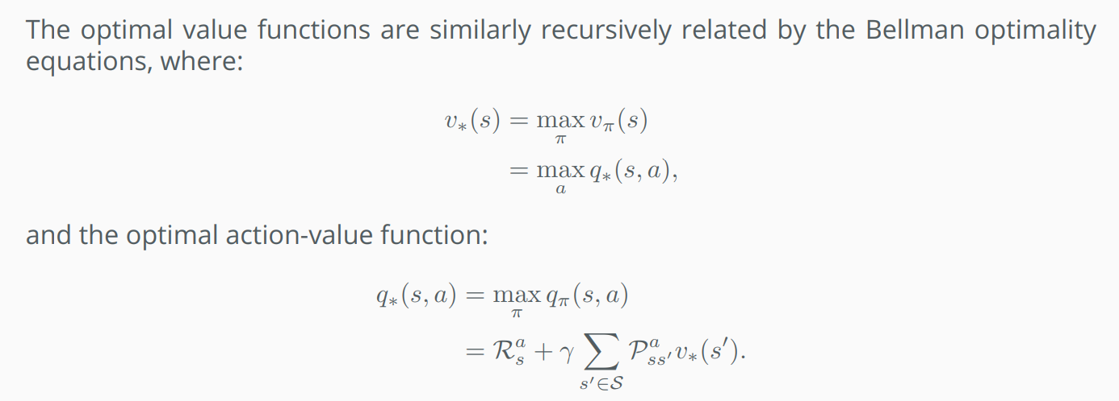
Optimality Equation

Slide 35


Values of States
Fundamental operation: compute the (expectimax) value of a state
Expected utility under optimal action
Average sum of (discounted) rewards
This is just what expectimax computed!
Recursive definition of value:
s
a
s, a
s,a,s’
s’

Slide 36
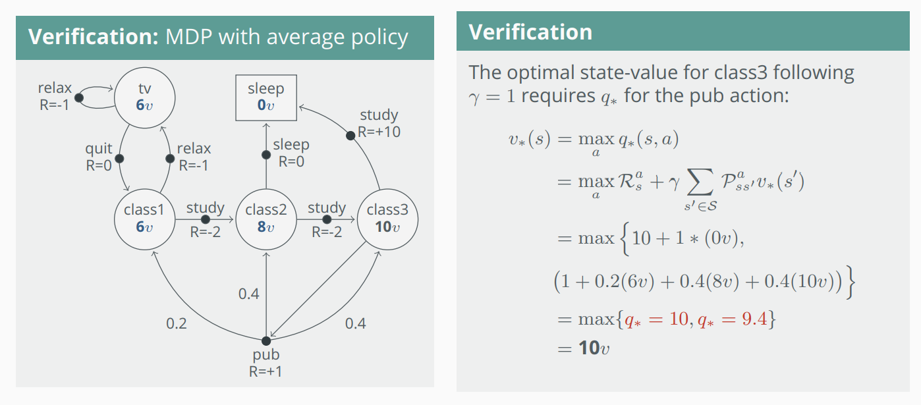
Optimality Equation

Slide 37
Recap: MDPs
Markov decision processes:
States S
Actions A
Transitions P(s’|s,a) (or T(s,a,s’))
Rewards R(s,a,s’) (and discount γ)
Start state s₀
Quantities:
Policy = map of states to actions
Utility = sum of discounted rewards
Values = expected future utility from a state (max node)
Q-Values = expected future utility from a q-state (chance node)
s
a
s, a
s,a,s’
s’

Slide 38

Next Week: Reinforcement Learning!

